Slide 1
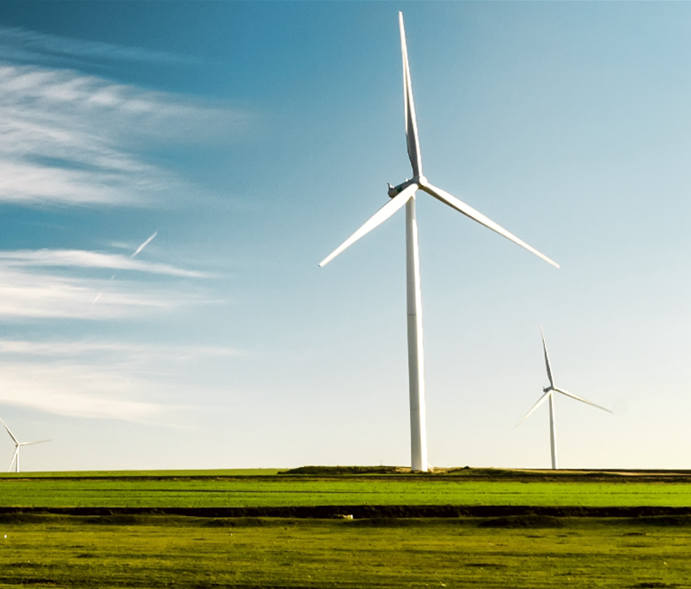



Optimal Bidding Prices
for the
UK Energy Market

Slide 2
Before we begin…

Slide 3
We have a question for you…

Slide 4
When was the last time you went out of your comfort zone?
Notes:
(When was the last time you did something for the first time?)

Slide 5
The story of many of us…

Slide 6
Being that said…

Slide 7










The UK rollercoaster ride…
Notes:
Get ready to witness a rollercoaster ride through the unpredictable twists and turns of the United Kingdom's energy market, where forecasting prices are like trying to predict the weather in England - you'll need equal parts luck, wit, and an umbrella.

Slide 8




Qualitas Energy´s Challenge
A
G
E
N
D
A
Q7 Intel Value Proposition
Energy Market
Data Preprocessing
Machine Learning Model + Results
Business Impact
Next Steps + Recommendations

Slide 9







Our Team
Javier
del Cid
Denisa
Cekrezi
Luis
Fernández
Federico
Álvarez-Labrador
María
del Caño
Miguel
Bohórquez

Slide 10
Qualitas Energy
Qualitas Energy mission is to drive the change towards a decarbonized economy.
Focusing their investments into energy transition and sustainability-related assets.
+16 years
Of profitable track record in Renewable Energy investments
€11bn
Capital invested since 2006
7 Countries
With realized investments
Solar
Wind
Batteries
Renewable Natural Gas
Hydro
+ 5 GW
Current Energy Portfolio
11GW
In our historic portfolio of operating and development energy assets
In Operation
0.8 GW
In Development
4.9 GW
Notes:
Luis: (IVAN)
Do not read what´s on the screen.
Try to find a project the company is working on, and people can feel related. Empathize the idea of 11 Billion.
How much is a GW? This could power Spain for XX amount of time.
Make it feel like something more than just reading on the screen, something relatable. (Filippo)
INTRODUCIR LA IMPORTANCIA DE LAS BATERÍAS PARA EL CLIENTE.

Slide 11
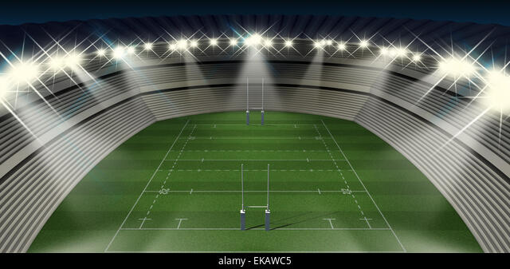
1 Rugby Stadium for 500 years
≈ 10.000 matches

Slide 12
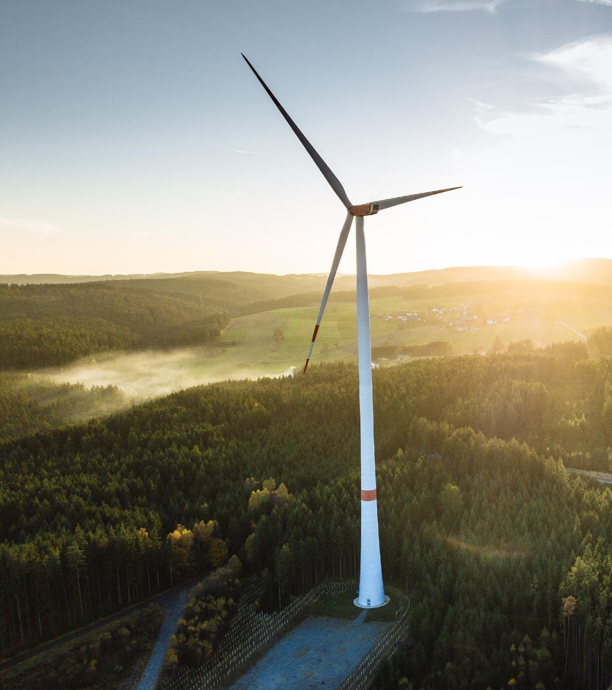
Challenge
Understand an adjustments energy market
by the study of the
historical transactions.
Predict the optimal price
for the future.

Slide 13
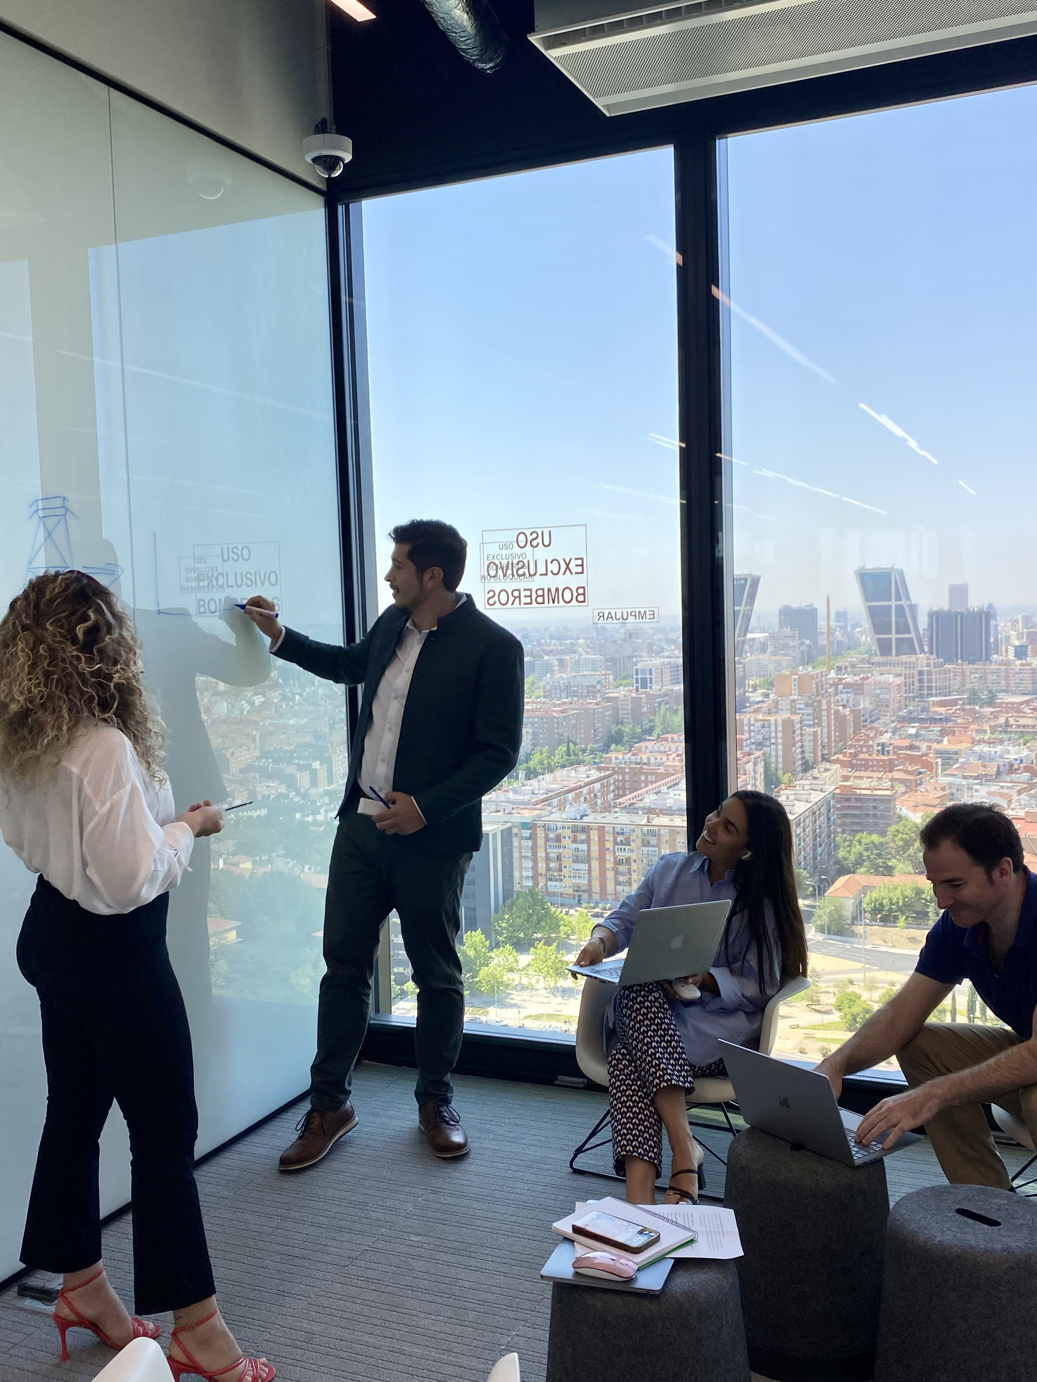
Q7 Intel Value Proposition
Based on the historical data:
Predict the price of the transaction regarding on the following characteristics, among others:
£
Location
Technology Type
Size
Predict the average price in the geographic areas of energy distribution.
Notes:
Our team can help Q energy significantly increase the profitability providing:

Slide 14

Objectives
Introduce Qualitas Energy in a new market
Revenue
Profits
Improve decision making
Notes:
Our team can help Q energy significantly increase the profitability providing:

Slide 15
Process
Market Analysis
Data Preprocessing
Machine Learning Models
Best Models & Conclusions

Slide 16

Process
Market Analysis
Data Preprocessing
Machine Learning Models
Best Models & Conclusions
The Balancing Mechanism is the market used by National Grid to solve grid constraints and to match supply and demand in real time in the UK.
Intraday
Auction

Slide 17
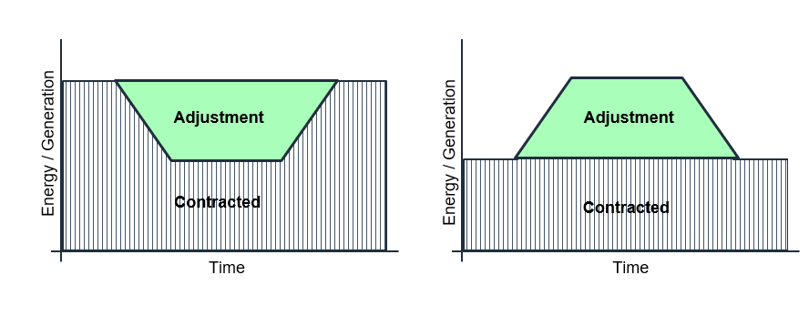


Process
Market Analysis
Data Preprocessing
Machine Learning Models
Best Models & Conclusions
BID
OFFER
Balancing Mechanism Unit BMU
(+)
(-)
1 Day = 48 Settlement Periods
1 Day = 48 Settlement Periods

Slide 18
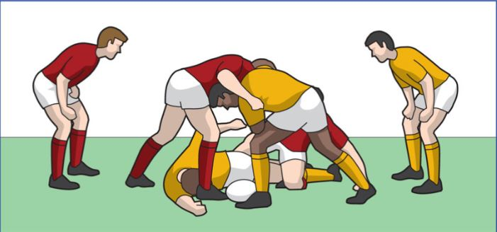
Any 30 min Time Period = 1 Settlement Period
Let´s think about Rugby
30 min
30 min
30 min
30 min
Notes:
It´s a game starting over every 30 minutes.

Slide 19
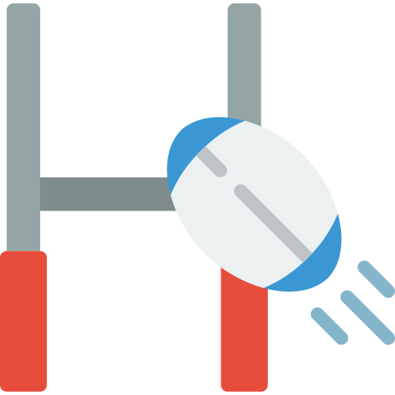












What is happening in a Settlement Period (SP)?
Rugby Ground:
United Kingdom
divided by Geo-Zone.
Timeframe:
30 min.
48 per day.
Players:
BMU´s
+
Balance
Referee:
National Grid
-
What is the goal? Balanced Supply-Demand
How do we achieve it? Accepted transactions.
Notes:
Why is the star the star?
It buys when it´s cheap, and sells when it´s expensive.
That is where we come in as Q7.

Slide 20


National Grid
Balancing Mechanism Units
Accepted Transactions
Notes:
Why is the star the star?
It buys when it´s cheap, and sells when it´s expensive.
That is where we come in as Q7.

Slide 21

Process
Market Analysis
Data Preprocessing
Machine Learning Models
Best Models & Conclusions
Actions
Collection
Cleaning
Transformation
Implementation
Discretization
Notes:
Añadir características de las partes.

Slide 22




Process
Market Analysis
Data Preprocessing
Machine Learning Models
Best Models & Conclusions
Offer/ Bid
BMUs
Energy Market
Raw Materials
Main Data Sources
Notes:
Añadir características de las partes.

Slide 23




Process
Market Analysis
Data Preprocessing
Machine Learning Models
Best Models & Conclusions
Tree
Ensembles
Tree Ensemble
Notes:
Múltiples pruebas han llevado a:
Modelo BIDS
Modelo OFFERS
Modelo particularizado a ofertas
Modelo de predicción precio medio
Root dividing in the branches. – Does the same with the data set. Relationship between features and variables.

Slide 24


Process
Market Analysis
Data Preprocessing
Machine Learning Models
Best Models & Conclusions
Tree Ensemble
Bids / Offers
Transactions /
Geo-zones
Notes:
Múltiples pruebas han llevado a:
Modelo BIDS
Modelo OFFERS
Modelo particularizado a ofertas
Modelo de predicción precio medio

Slide 25






Process
Market Analysis
Data Preprocessing
Machine Learning Models
Best Models & Conclusions
OFFERS
Transaction
Ensembles
XG Boost
Geo-zone
BIDS
Transaction
Geo-zone
Notes:
- POSIBLE MOVIMIENTO A ANEXOS

Slide 26

Process
Market Analysis
Data Preprocessing
Machine Learning Models
Best Models & Conclusions
Transaction
Geo-zone
BIDS
Error = 16.16%
Price = 41.87 £/Mw
Error = 23.14%
Price = 45.28 £/Mw
BMU
OFFERS
Error = 8.33%
Price = 128.89 £/Mw
Error = 8.33%
Price = 128.89 £/Mw
Error = 8.31%
Price = 128.45 £/Mw
Error = 8.31%
Price = 128.45 £/Mw
=
* Forecasting only 1 Settlement Period (SP) ahead.
Price +/- Error%

Slide 27
Business Impact
Our model aims to predict prices for the
Balancing Mechanism
The proposal must be
accepted by National Grid, given:
£
Price
Location
Technology Type
Size
Notes:
Let's bear in mind that our model aims to predict transaction prices in the intraday market auction.
Now, I want you to closely examine this chart, but also not get too lost in the details. The Y-axis represents the margin of error Fede mentioned, while each blue point represents a prediction. Notice that the majority of predictions fall within a 15% margin of error for OFFER type transactions. This level of accuracy is truly impressive!
Take note of that.
Moving on, we want to gauge the value of the Intraday Market, and our estimation places it at around 65 million pounds by year-end.
Now, let's conduct an exercise with batteries participating in the Balancing Mechanism, representing a market share of approximately 2-3%. A 15% increase in their transaction acceptance rate would result in a revenue boost in the range of 245 thousand pounds.
This exercise can be replicated for any type of BMU participating in the Balancing Mechanism, as the it is the way the model was designed.
For our next steps, we should explore the opportunity cost of participating in this market or other day markets, instead of the Balancign Mechanism.
But for now, I'll pass the mic back to Denisa to take us through the next steps and recommendations.

Slide 28
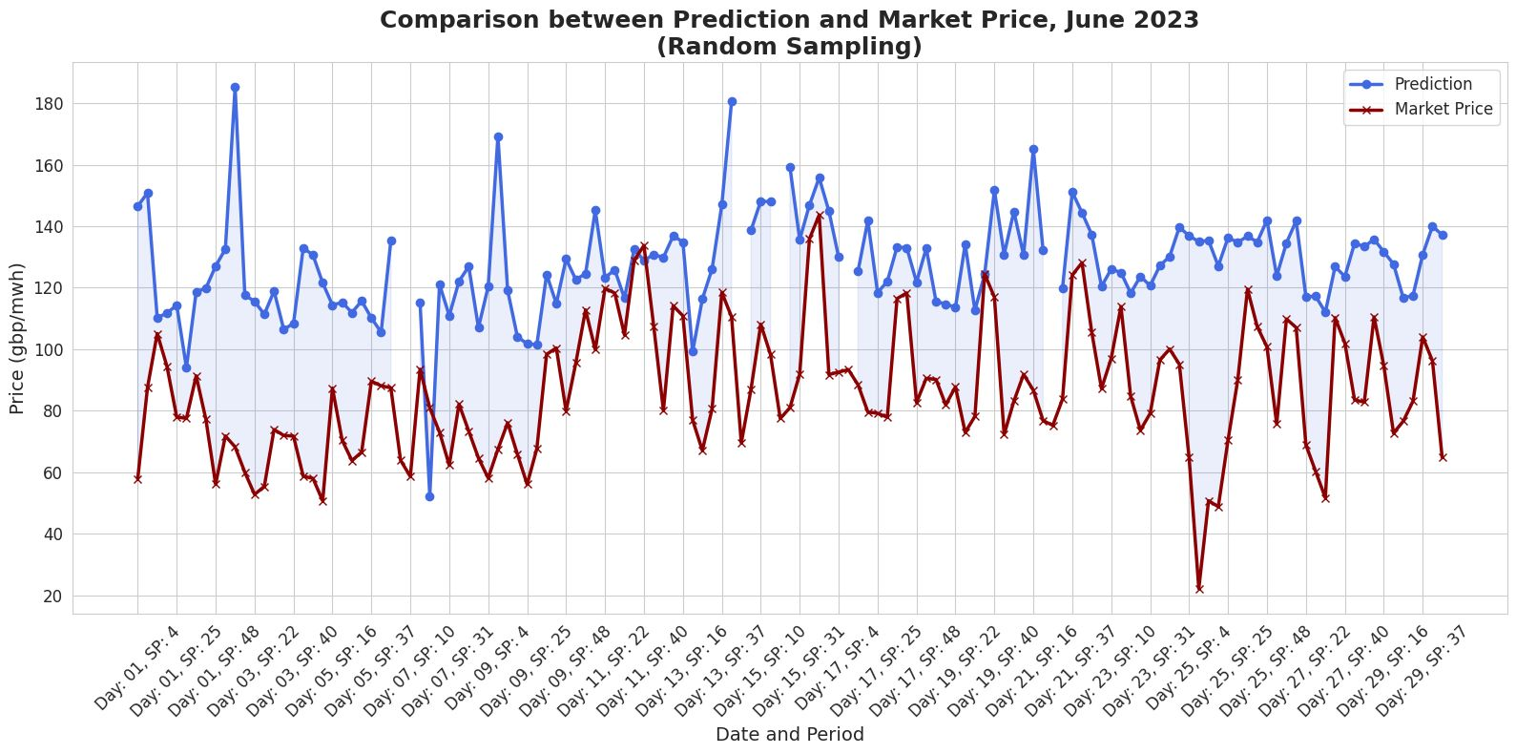
Business Impact
Notes:
Let's bear in mind that our model aims to predict transaction prices in the intraday market auction.
Now, I want you to closely examine this chart, but also not get too lost in the details. The Y-axis represents the margin of error Fede mentioned, while each blue point represents a prediction. Notice that the majority of predictions fall within a 15% margin of error for OFFER type transactions. This level of accuracy is truly impressive!
Take note of that.
Moving on, we want to gauge the value of the Intraday Market, and our estimation places it at around 65 million pounds by year-end.
Now, let's conduct an exercise with batteries participating in the Balancing Mechanism, representing a market share of approximately 2-3%. A 15% increase in their transaction acceptance rate would result in a revenue boost in the range of 245 thousand pounds.
This exercise can be replicated for any type of BMU participating in the Balancing Mechanism, as the it is the way the model was designed.
For our next steps, we should explore the opportunity cost of participating in this market or other day markets, instead of the Balancign Mechanism.
But for now, I'll pass the mic back to Denisa to take us through the next steps and recommendations.

Slide 29

Javi
1 min
Business Impact
Balancing Mechanism
Vs
Alternative Markets
Business Case
Wholesale Market Avg ≈ 86 £/mwh
Solar Power 500Mw Plant
Balancing Mechanism avg ≈ 127 £/mwh
Marginal Increase per Unit ≈ 41 £/mwh
Marginal Increase Avg ≈ 50%
Technology Type:
Notes:
Moving on, we want to gauge the value of the Intraday Market, and our estimation places it at around 65 million pounds by year-end.
Now, let's conduct an exercise with batteries participating in the Balancing Mechanism, representing a market share of approximately 2-3%. A 15% increase in their transaction acceptance rate would result in a revenue boost in the range of 245 thousand pounds.
This exercise can be replicated for any type of BMU participating in the Balancing Mechanism, as the it is the way the model was designed.
For our next steps, we should explore the opportunity cost of participating in this market or other day markets, instead of the Balancign Mechanism.
But for now, I'll pass the mic back to Denisa to take us through the next steps and recommendations.

Slide 30
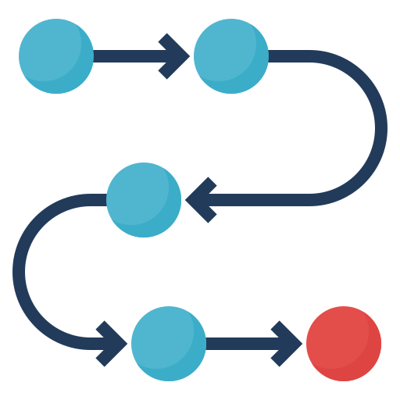



Next Steps + Recommendations
Model Implementation and Decision Support.
Market Intelligence.
Incorporate Real-Time Data.
Outliers – “rare cases”.
Not Accepted Transactions Analysis.
Deep analysis of the type of technology.
Notes:
Add EDA graph BMU unit , per price , compare gas or any other BMU unit with Battery
Compare volume and price.
Incremento de las baterías en los últimos años. (participación).
ML + BATERÍAS (Flexible Assets)

Slide 31

Next Steps + Recommendations
Model Implementation and Decision Support.
Market Intelligence.
Incorporate Real-Time Data.
Outliers – “rare cases”.
Not Accepted Transactions Analysis.
Deep analysis of the type of technology.
Notes:
Embrace Energy Storage: Invest in energy storage infrastructure to capture the benefits of peak shaving, arbitrage, frequency regulation, and grid services.
Market Intelligence and Forecasting: Invest in advanced data analytics and forecasting capabilities to gain insights into market trends, pricing dynamics, and demand patterns.
Integration and Decision Support: Integrate the machine learning model into Qualitas Energy's decision-making processes and use the predicted prices to optimize bidding strategies, inform asset dispatch decisions, or support risk management activities. Ensure that the predictions are effectively communicated and utilized by relevant stakeholders within the organization.
Continuous Improvement: Regularly monitor and evaluate the model's performance, updating it as new data becomes available and incorporating feedback from market observations.
Incorporate Real-Time Data: Integrate real-time data streams into the model for continuous updates and predictions. This could include real-time pricing data, weather forecasts, or other relevant data sources. Adjust the model's predictions based on the most up-to-date information.
Environmental and Sustainability Considerations: Increasingly, environmental and sustainability factors play a role in the energy market. Bids and offers that incorporate renewable energy sources, energy storage, demand response, or other low-carbon technologies can align with sustainability goals and attract potential buyers.
Notas:
Os acordais de el mapa donde iban saliendo assets?
Todo este Proyecto se ha construdio para optimizar el uso de las baterías
Comprar energía en momentos alta generación y venderlo en momento de alta demanda
Maximaze the spread

Slide 32

Next Steps + Recommendations
Model Implementation and Decision Support.
Market Intelligence.
Incorporate Real-Time Data.
Outliers – “rare cases”.
Not Accepted Transactions Analysis.
Deep analysis of the type of technology.
Notes:
Embrace Energy Storage: Invest in energy storage infrastructure to capture the benefits of peak shaving, arbitrage, frequency regulation, and grid services.
Market Intelligence and Forecasting: Invest in advanced data analytics and forecasting capabilities to gain insights into market trends, pricing dynamics, and demand patterns.
Integration and Decision Support: Integrate the machine learning model into Qualitas Energy's decision-making processes and use the predicted prices to optimize bidding strategies, inform asset dispatch decisions, or support risk management activities. Ensure that the predictions are effectively communicated and utilized by relevant stakeholders within the organization.
Continuous Improvement: Regularly monitor and evaluate the model's performance, updating it as new data becomes available and incorporating feedback from market observations.
Incorporate Real-Time Data: Integrate real-time data streams into the model for continuous updates and predictions. This could include real-time pricing data, weather forecasts, or other relevant data sources. Adjust the model's predictions based on the most up-to-date information.
Environmental and Sustainability Considerations: Increasingly, environmental and sustainability factors play a role in the energy market. Bids and offers that incorporate renewable energy sources, energy storage, demand response, or other low-carbon technologies can align with sustainability goals and attract potential buyers.
Notas:
Os acordais de el mapa donde iban saliendo assets?
Todo este Proyecto se ha construdio para optimizar el uso de las baterías
Comprar energía en momentos alta generación y venderlo en momento de alta demanda
Maximaze the spread

Slide 33

Next Steps + Recommendations
Model Implementation and Decision Support.
Market Intelligence.
Incorporate Real-Time Data.
Outliers – “rare cases”.
Not Accepted Transactions Analysis.
Deep analysis of the type of technology.
Notes:
Embrace Energy Storage: Invest in energy storage infrastructure to capture the benefits of peak shaving, arbitrage, frequency regulation, and grid services.
Market Intelligence and Forecasting: Invest in advanced data analytics and forecasting capabilities to gain insights into market trends, pricing dynamics, and demand patterns.
Integration and Decision Support: Integrate the machine learning model into Qualitas Energy's decision-making processes and use the predicted prices to optimize bidding strategies, inform asset dispatch decisions, or support risk management activities. Ensure that the predictions are effectively communicated and utilized by relevant stakeholders within the organization.
Continuous Improvement: Regularly monitor and evaluate the model's performance, updating it as new data becomes available and incorporating feedback from market observations.
Incorporate Real-Time Data: Integrate real-time data streams into the model for continuous updates and predictions. This could include real-time pricing data, weather forecasts, or other relevant data sources. Adjust the model's predictions based on the most up-to-date information.
Environmental and Sustainability Considerations: Increasingly, environmental and sustainability factors play a role in the energy market. Bids and offers that incorporate renewable energy sources, energy storage, demand response, or other low-carbon technologies can align with sustainability goals and attract potential buyers.
Notas:
Os acordais de el mapa donde iban saliendo assets?
Todo este Proyecto se ha construdio para optimizar el uso de las baterías
Comprar energía en momentos alta generación y venderlo en momento de alta demanda
Maximaze the spread

Slide 34

Next Steps + Recommendations
Model Implementation and Decision Support.
Market Intelligence.
Incorporate Real-Time Data.
Outliers – “rare cases”.
Not Accepted Transactions Analysis.
Deep analysis of the type of technology.
Notes:
Embrace Energy Storage: Invest in energy storage infrastructure to capture the benefits of peak shaving, arbitrage, frequency regulation, and grid services.
Market Intelligence and Forecasting: Invest in advanced data analytics and forecasting capabilities to gain insights into market trends, pricing dynamics, and demand patterns.
Integration and Decision Support: Integrate the machine learning model into Qualitas Energy's decision-making processes and use the predicted prices to optimize bidding strategies, inform asset dispatch decisions, or support risk management activities. Ensure that the predictions are effectively communicated and utilized by relevant stakeholders within the organization.
Continuous Improvement: Regularly monitor and evaluate the model's performance, updating it as new data becomes available and incorporating feedback from market observations.
Incorporate Real-Time Data: Integrate real-time data streams into the model for continuous updates and predictions. This could include real-time pricing data, weather forecasts, or other relevant data sources. Adjust the model's predictions based on the most up-to-date information.
Environmental and Sustainability Considerations: Increasingly, environmental and sustainability factors play a role in the energy market. Bids and offers that incorporate renewable energy sources, energy storage, demand response, or other low-carbon technologies can align with sustainability goals and attract potential buyers.
Notas:
Os acordais de el mapa donde iban saliendo assets?
Todo este Proyecto se ha construdio para optimizar el uso de las baterías
Comprar energía en momentos alta generación y venderlo en momento de alta demanda
Maximaze the spread

Slide 35

Next Steps + Recommendations
Model Implementation and Decision Support.
Market Intelligence.
Incorporate Real-Time Data.
Outliers – “rare cases”.
Not Accepted Transactions Analysis.
Deep analysis of the type of technology.
Notes:
Embrace Energy Storage: Invest in energy storage infrastructure to capture the benefits of peak shaving, arbitrage, frequency regulation, and grid services.
Market Intelligence and Forecasting: Invest in advanced data analytics and forecasting capabilities to gain insights into market trends, pricing dynamics, and demand patterns.
Integration and Decision Support: Integrate the machine learning model into Qualitas Energy's decision-making processes and use the predicted prices to optimize bidding strategies, inform asset dispatch decisions, or support risk management activities. Ensure that the predictions are effectively communicated and utilized by relevant stakeholders within the organization.
Continuous Improvement: Regularly monitor and evaluate the model's performance, updating it as new data becomes available and incorporating feedback from market observations.
Incorporate Real-Time Data: Integrate real-time data streams into the model for continuous updates and predictions. This could include real-time pricing data, weather forecasts, or other relevant data sources. Adjust the model's predictions based on the most up-to-date information.
Environmental and Sustainability Considerations: Increasingly, environmental and sustainability factors play a role in the energy market. Bids and offers that incorporate renewable energy sources, energy storage, demand response, or other low-carbon technologies can align with sustainability goals and attract potential buyers.
Notas:
Os acordais de el mapa donde iban saliendo assets?
Todo este Proyecto se ha construdio para optimizar el uso de las baterías
Comprar energía en momentos alta generación y venderlo en momento de alta demanda
Maximaze the spread

Slide 36

Thank you!

Slide 37


Slide 38
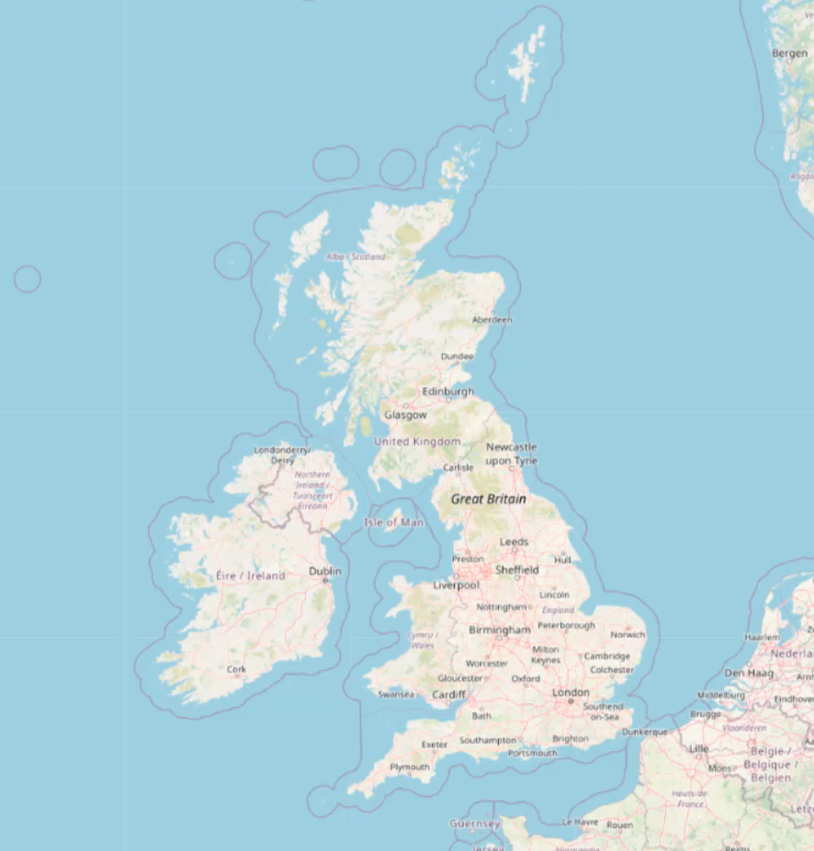

Slide 39
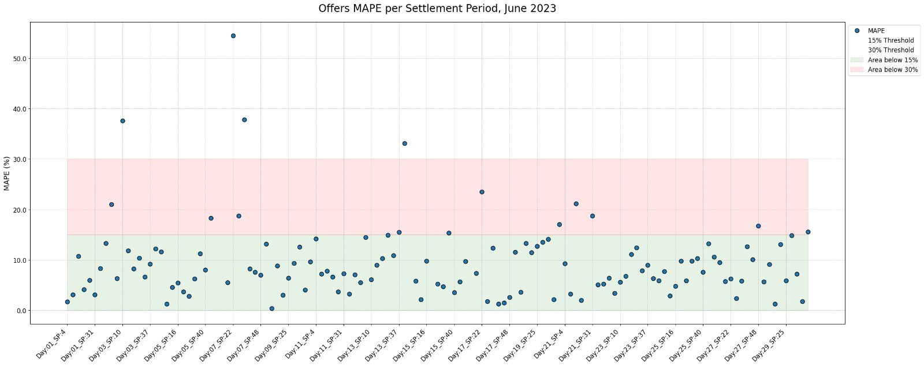
Business Impact
Notes:
Let's bear in mind that our model aims to predict transaction prices in the intraday market auction.
Now, I want you to closely examine this chart, but also not get too lost in the details. The Y-axis represents the margin of error Fede mentioned, while each blue point represents a prediction. Notice that the majority of predictions fall within a 15% margin of error for OFFER type transactions. This level of accuracy is truly impressive!
Take note of that.
Moving on, we want to gauge the value of the Intraday Market, and our estimation places it at around 65 million pounds by year-end.
Now, let's conduct an exercise with batteries participating in the Balancing Mechanism, representing a market share of approximately 2-3%. A 15% increase in their transaction acceptance rate would result in a revenue boost in the range of 245 thousand pounds.
This exercise can be replicated for any type of BMU participating in the Balancing Mechanism, as the it is the way the model was designed.
For our next steps, we should explore the opportunity cost of participating in this market or other day markets, instead of the Balancign Mechanism.
But for now, I'll pass the mic back to Denisa to take us through the next steps and recommendations.

